Slide 1
Day_6_Deployment_Preparation_ and _ Staging _ Environment
Uzma _ Ahmed
Roll no: 00448632
Sunday (2pm to 5pm)

Slide 2
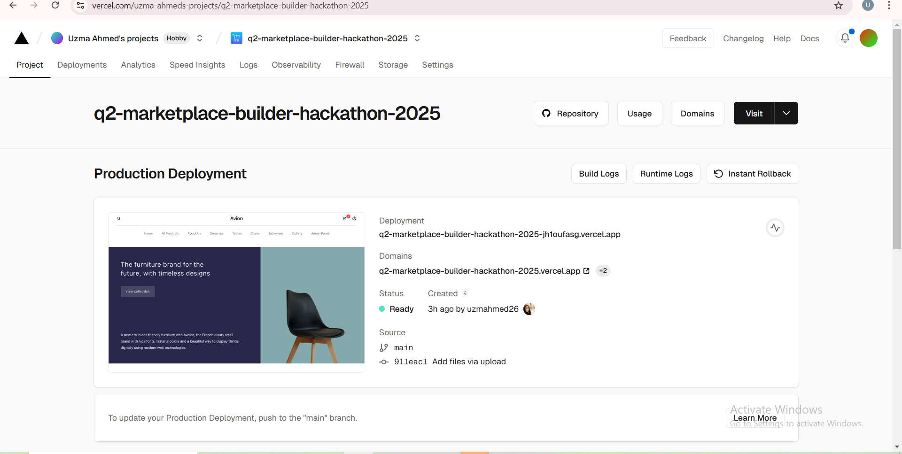
Deployment
Process for E-Commerce Project
1- Project Readiness
Ensured all components are functioning as expected through rigorous testing.
Finalized codebase, removing unnecessary files and logs to optimize the project.
Configured .env files for secure handling of sensitive credentials
(e.g., API keys, database connections).
2- Hosting Platform Selection
*Chose Vercel for its seamless integration with Next.js.
*Optional alternatives: Netlify, AWS, or Azure for scalable and global deployment.
3- Version Control
*Uploaded the project repository to GitHub for version control and easy deployment.
*Used Git commands to push the final branch to the main repository.
4- CI/CD Integration
*Enabled Continuous Integration/Continuous Deployment (CI/CD) pipelines
to automate builds and updates.
*Configured Vercel to auto-deploy on every push to the main branch.
5- Domain Setup
*Configured a custom domain name for the application for better accessibility and branding.
*Managed DNS settings for proper domain pointing to the hosting platform.

Slide 3
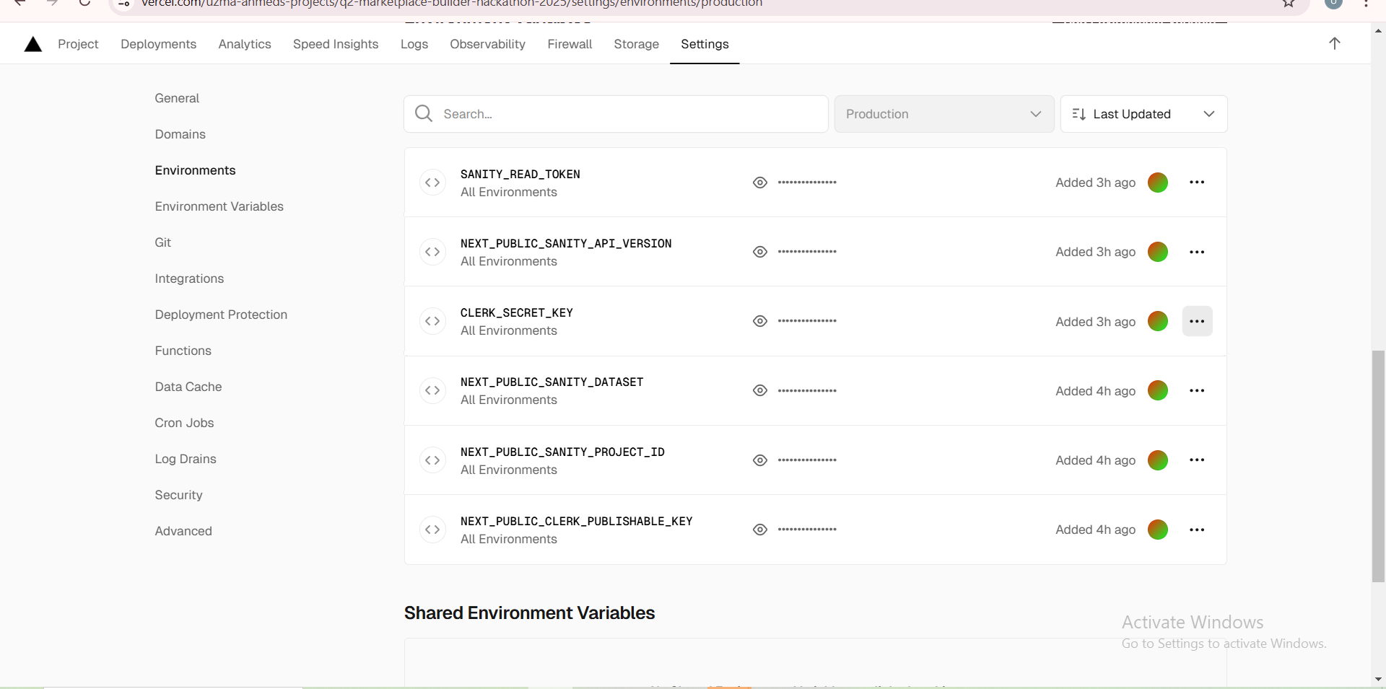
Deployment Process for E-Commerce Project
6 - Environment Variables
*Protected sensitive data by securely adding environment variables in the hosting platform's settings.
7- Performance Optimization
*Minified CSS and JavaScript files for faster loading times.
*Added lazy loading for images and components to enhance user experience.
*Implemented server-side rendering (SSR) and static site generation (SSG) using Next.js.
8 - Cross-Browser and Device Testing
* Performed final testing post-deployment to ensure compatibility across devices and browsers.
9 - Error Monitoring
* Integrated tools like Sentry or Vercel Analytics for tracking errors and performance
metrics in real-time.
10 - Deployment Verification
* Verified all pages and functionality in the live environment, including:
Authentication
Payment Gateway
Responsiveness
Navigation Flow
11 - Post-Deployment Maintenance
* Scheduled regular monitoring and updates to address any issues.
* Collected user feedback to improve the application further.

Slide 4
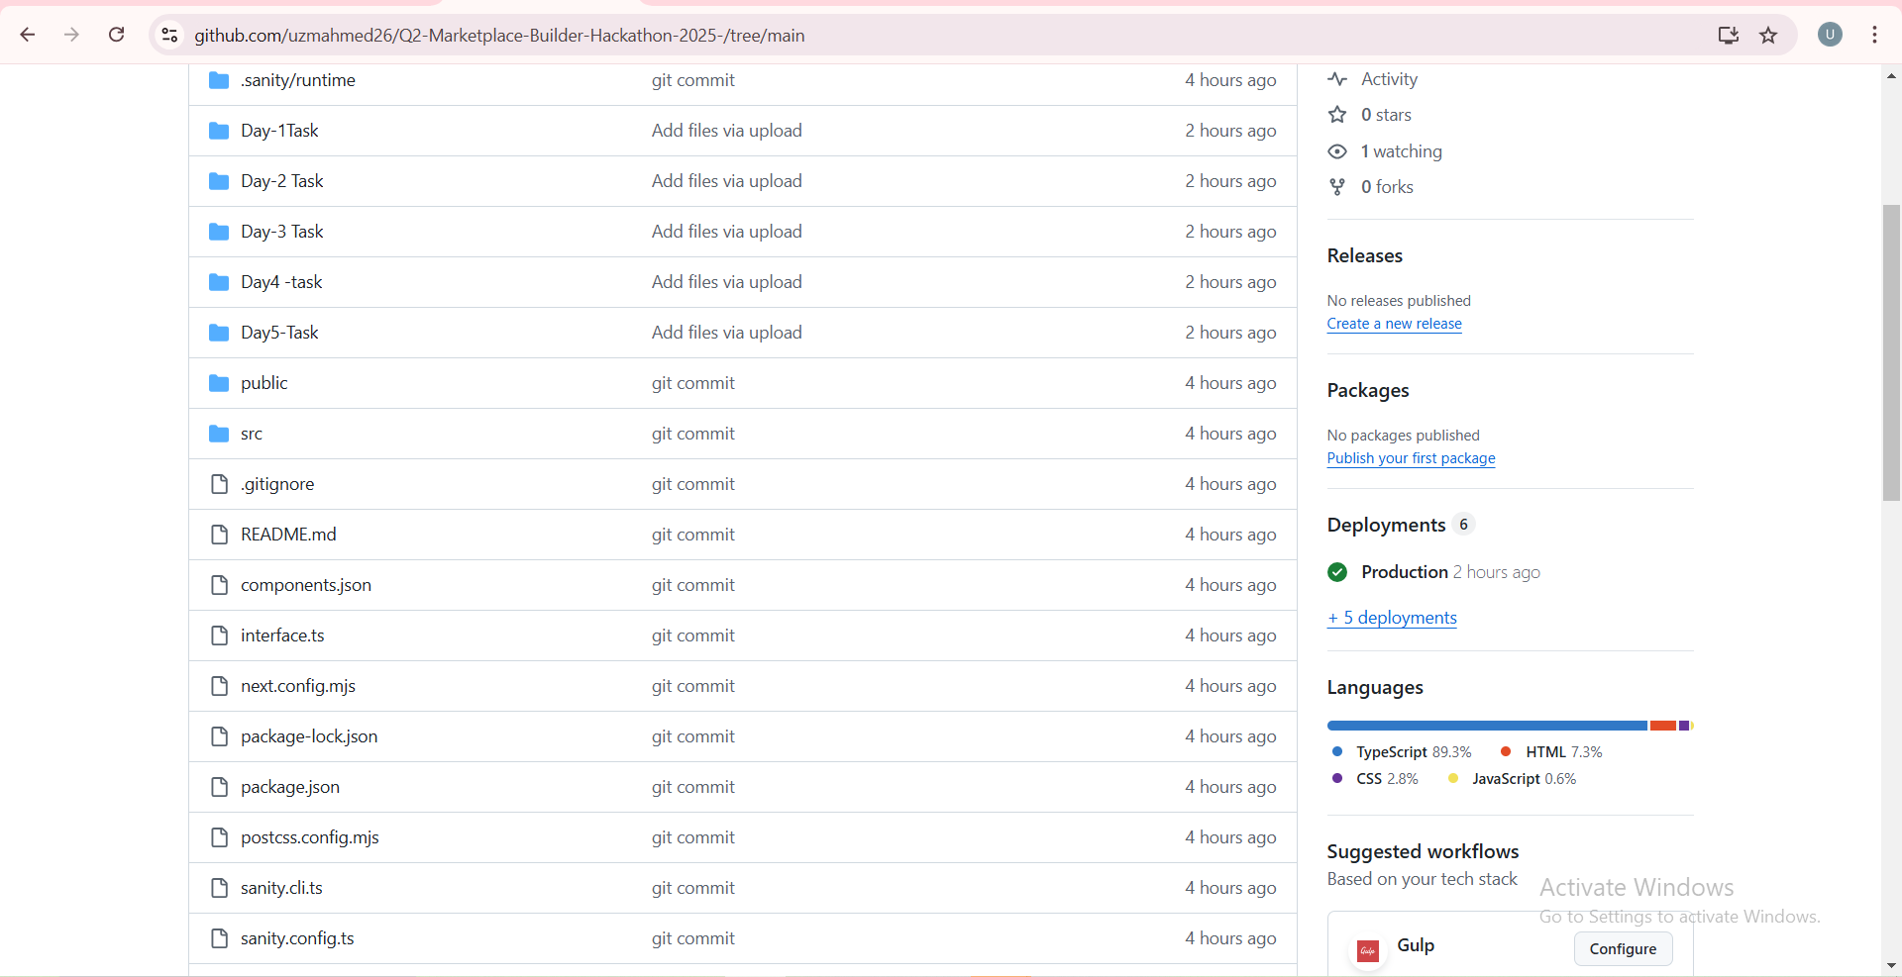
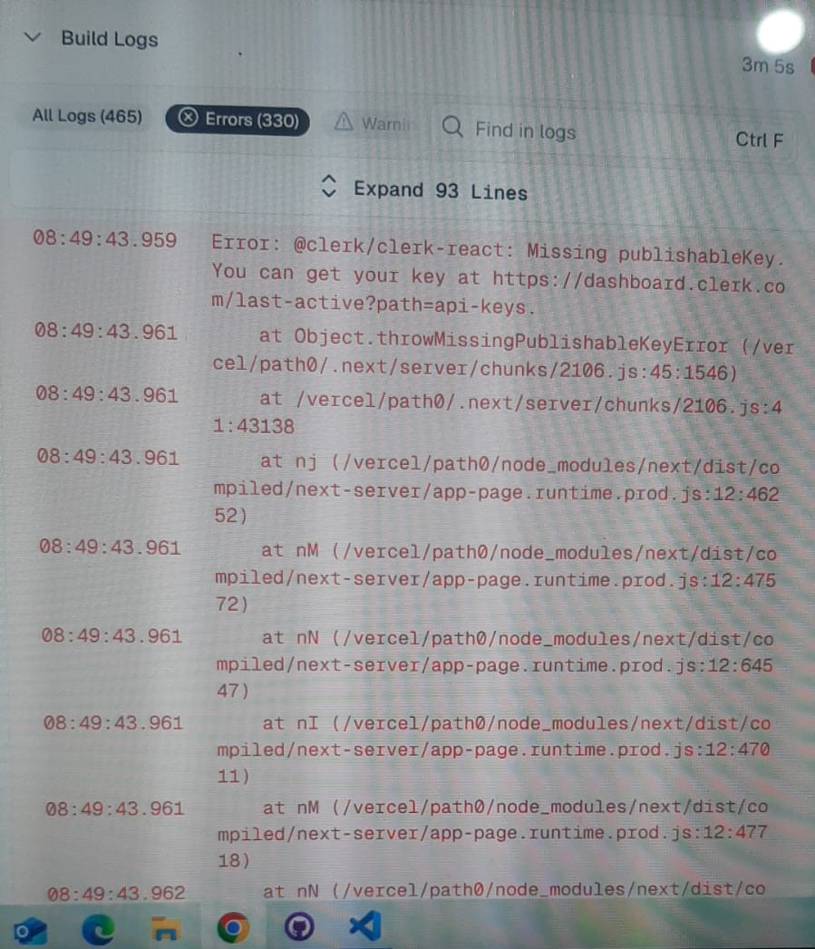
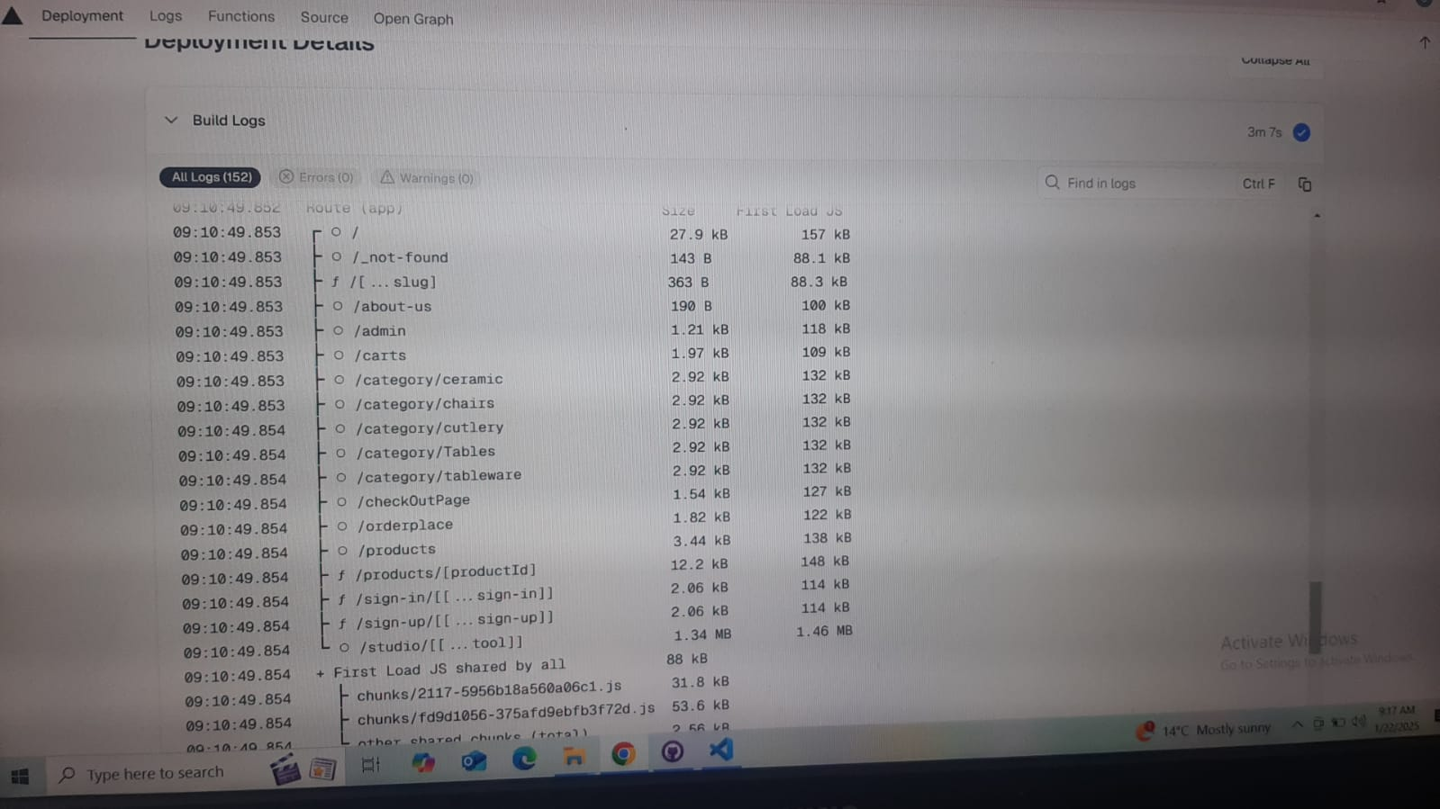
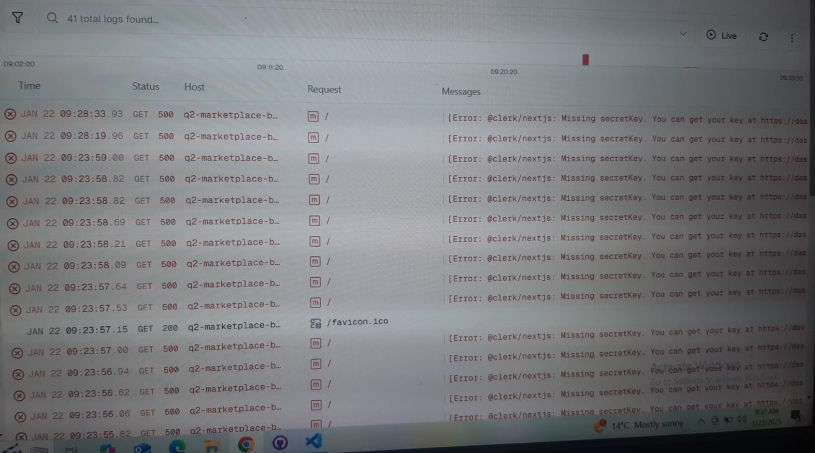
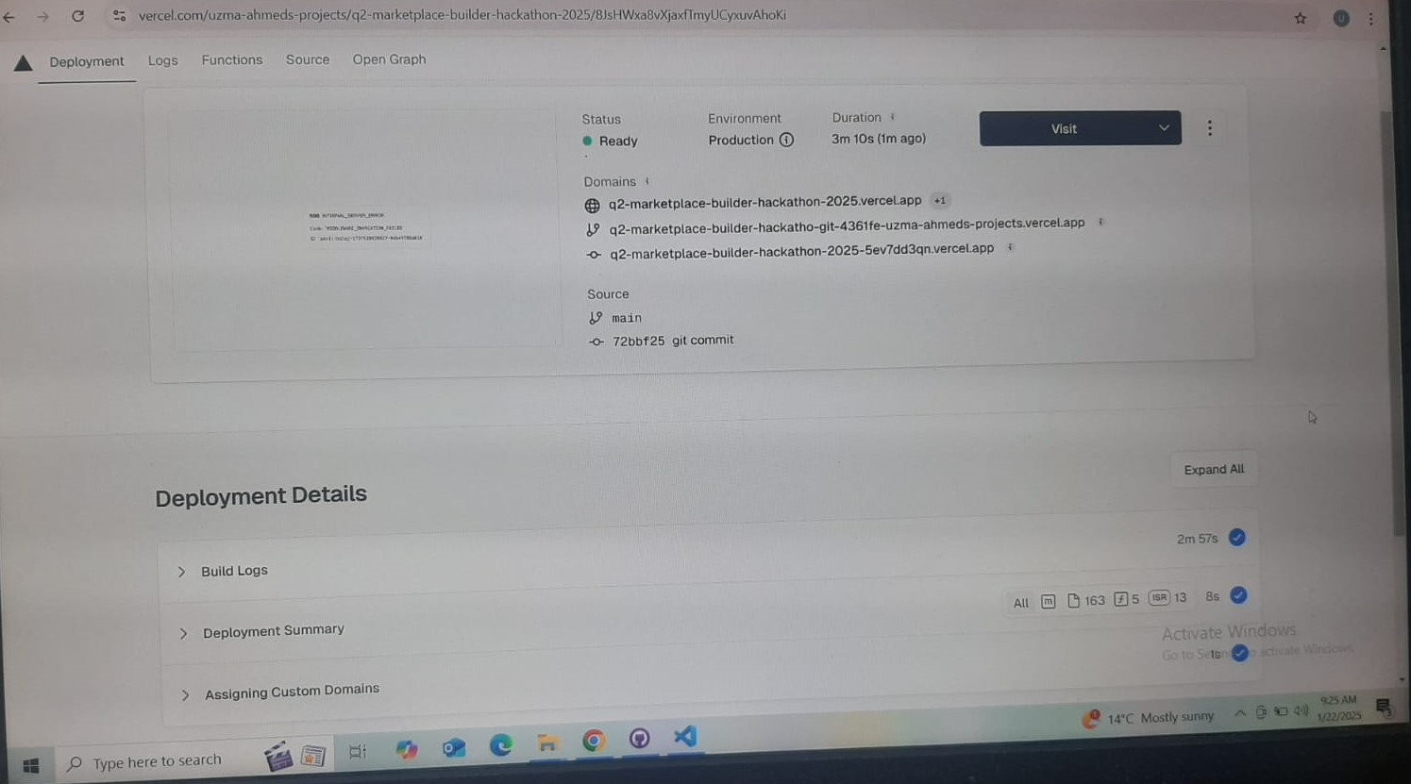
ERROR HANDLING
During the Vercel deployment, an error occurred due to missing environment variables and incorrect file paths. To resolve this, I added the required environment variables in the Vercel dashboard, corrected the file paths to match Vercel 's case-sensitive system, and ensured all dependencies were compatible. After applying these fixes, the project deployed successfully without any further issues.

Slide 5
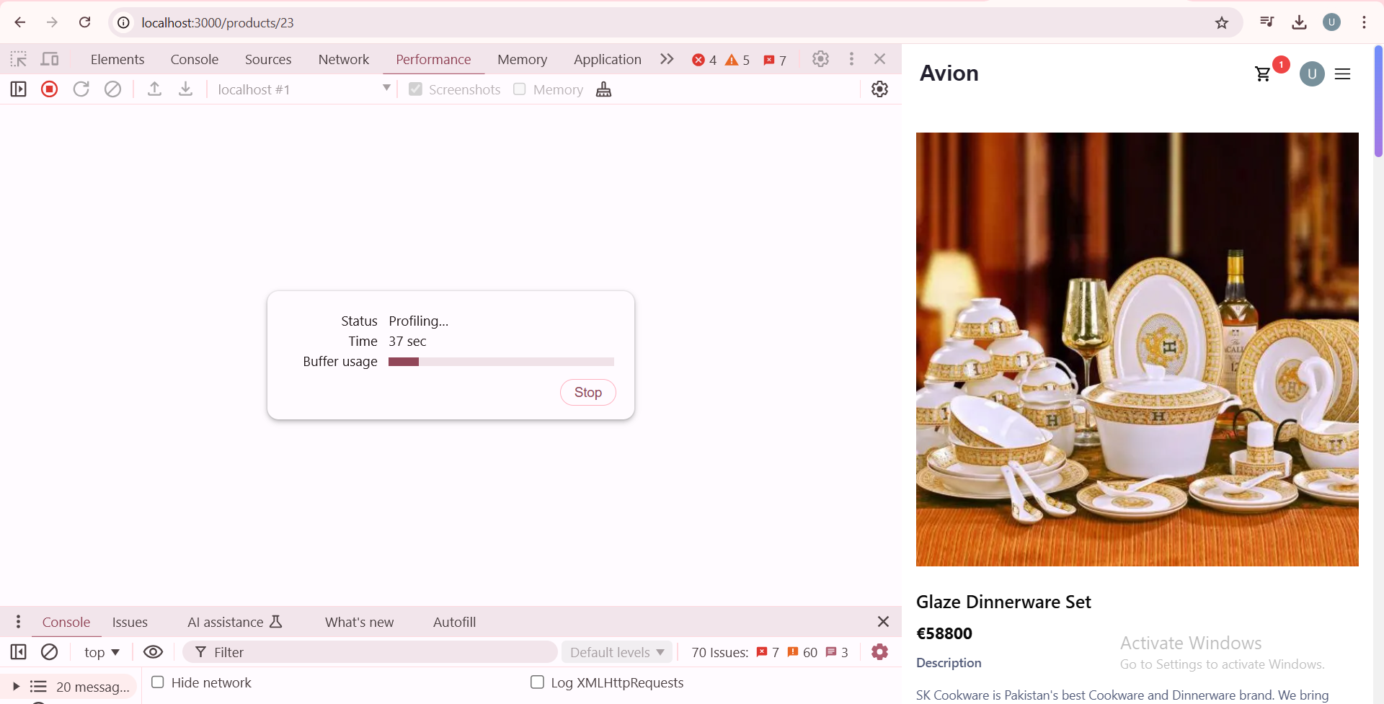
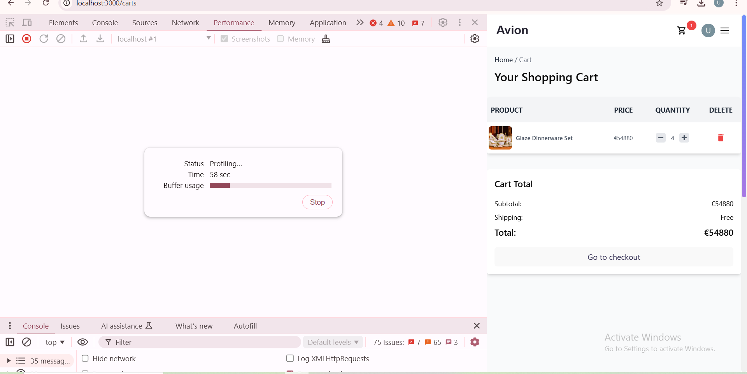
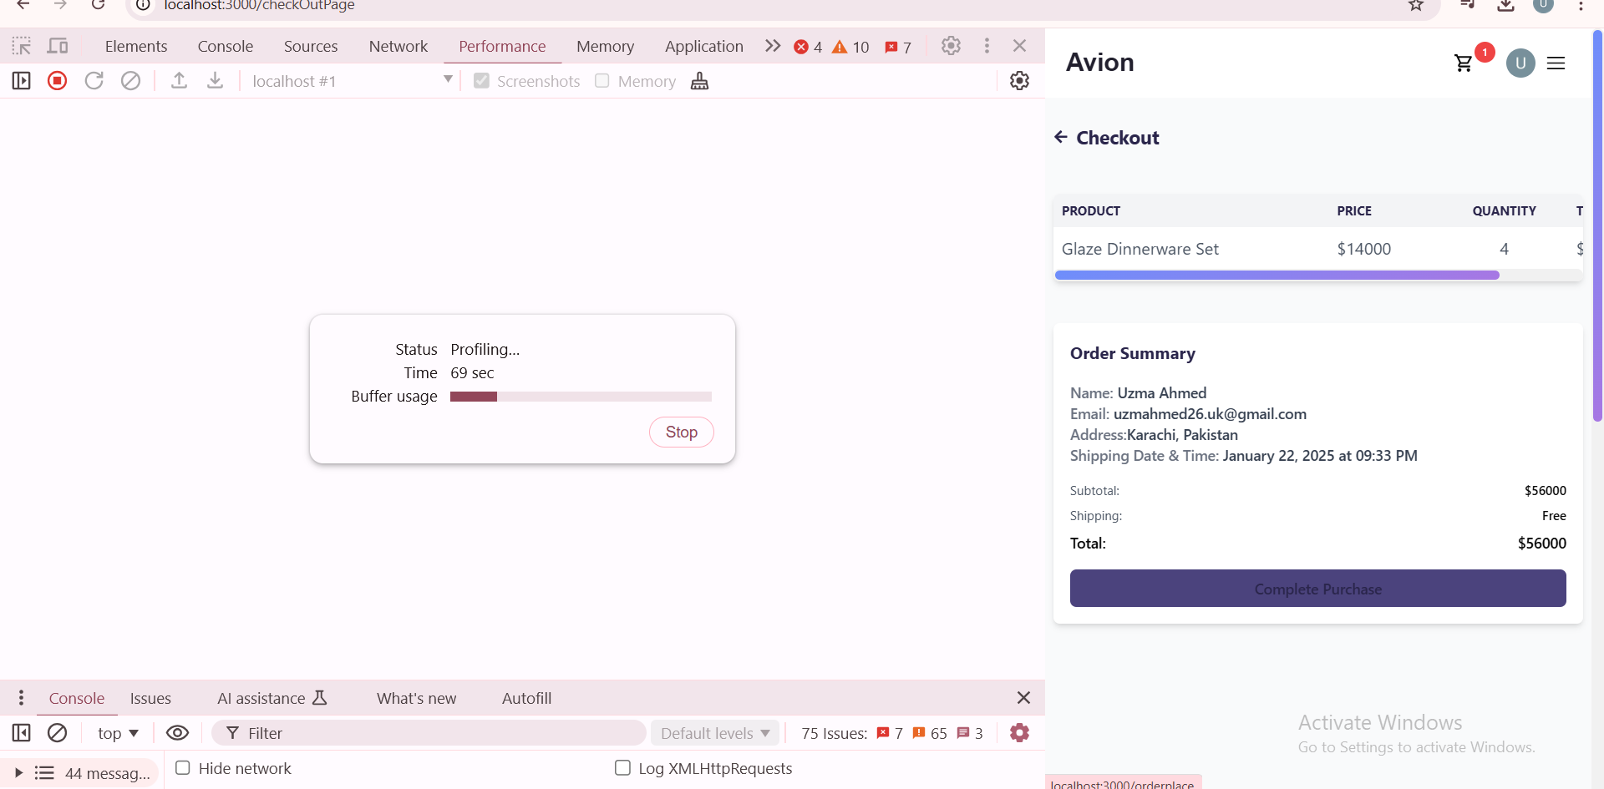
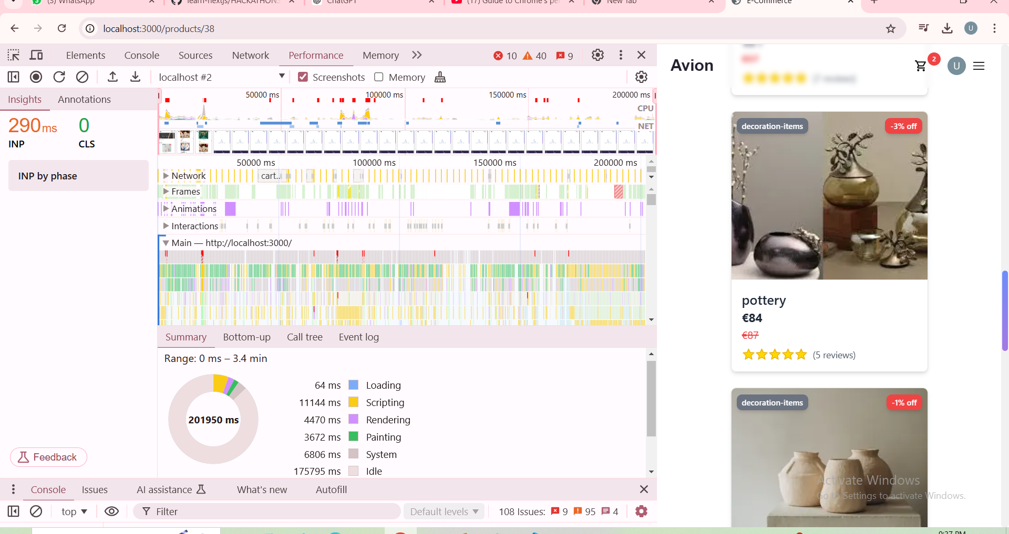
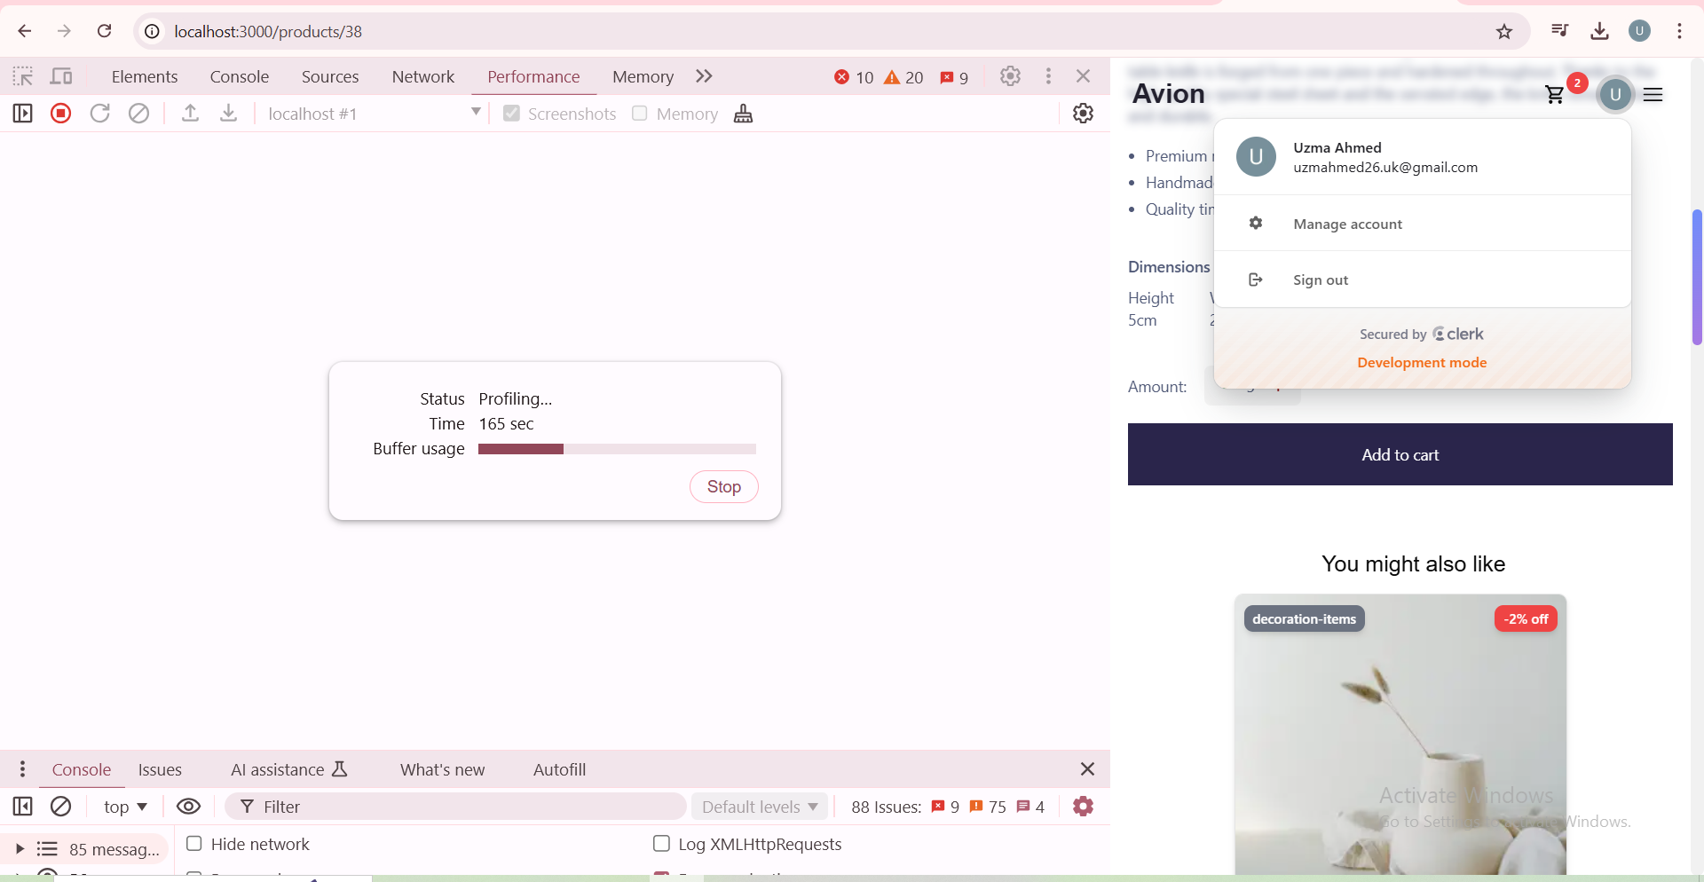
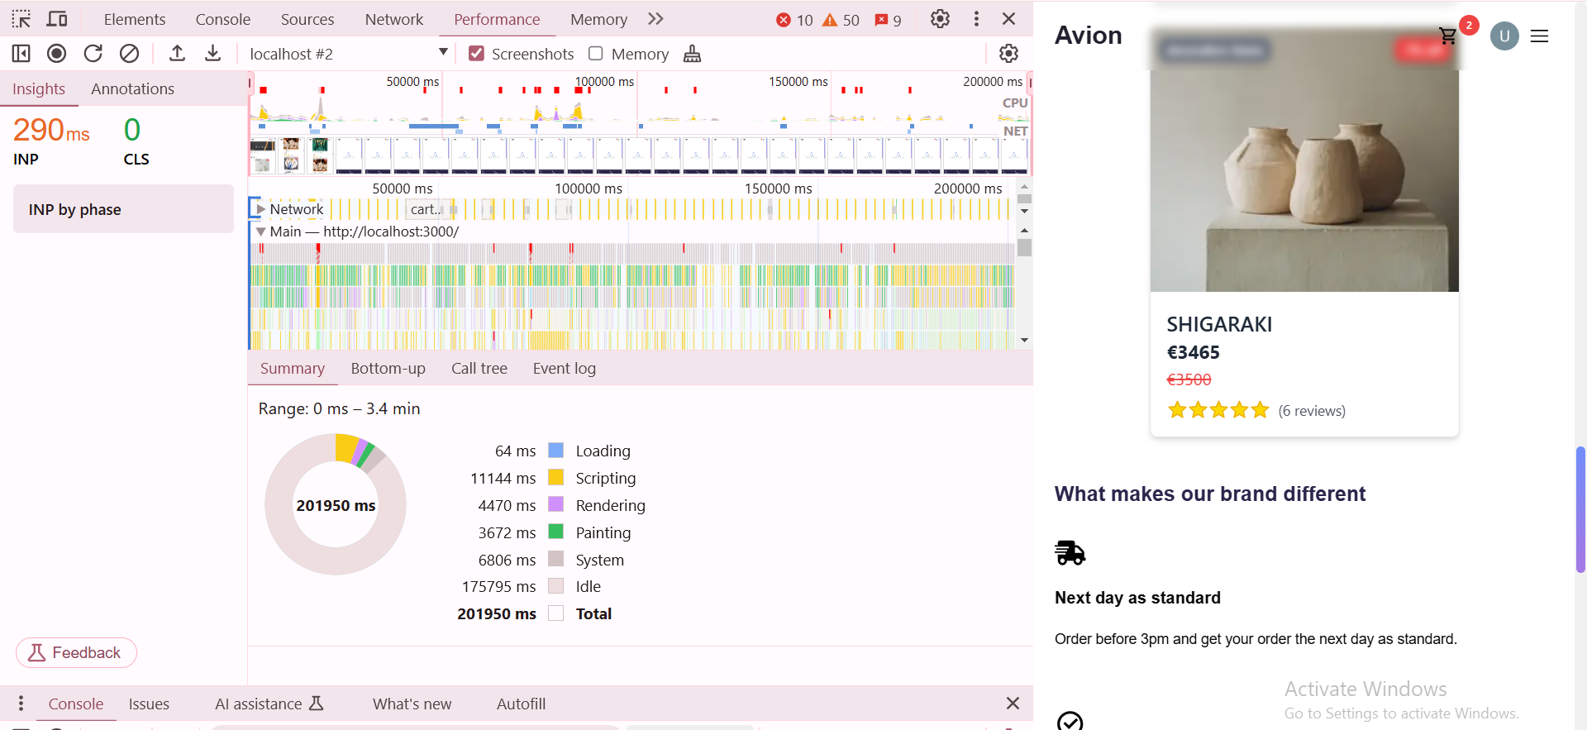
PERFORMANCE

Slide 6
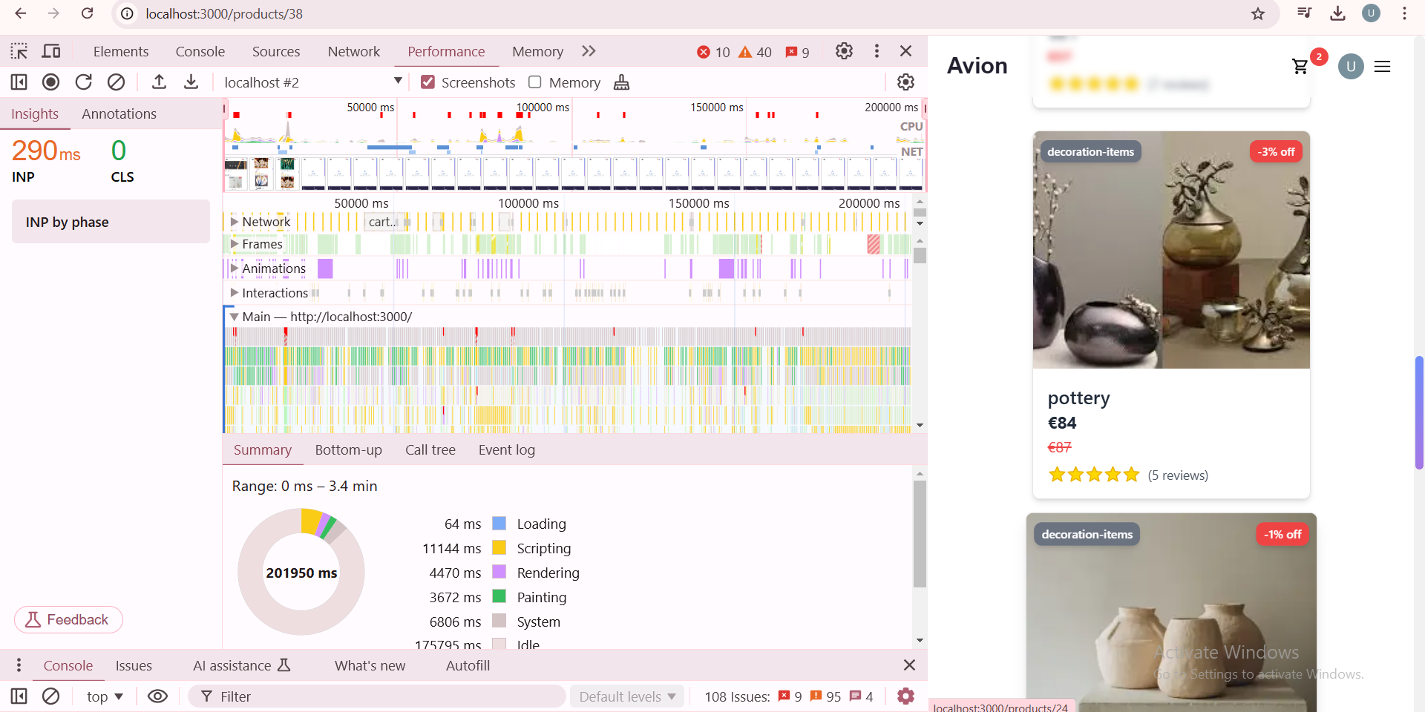
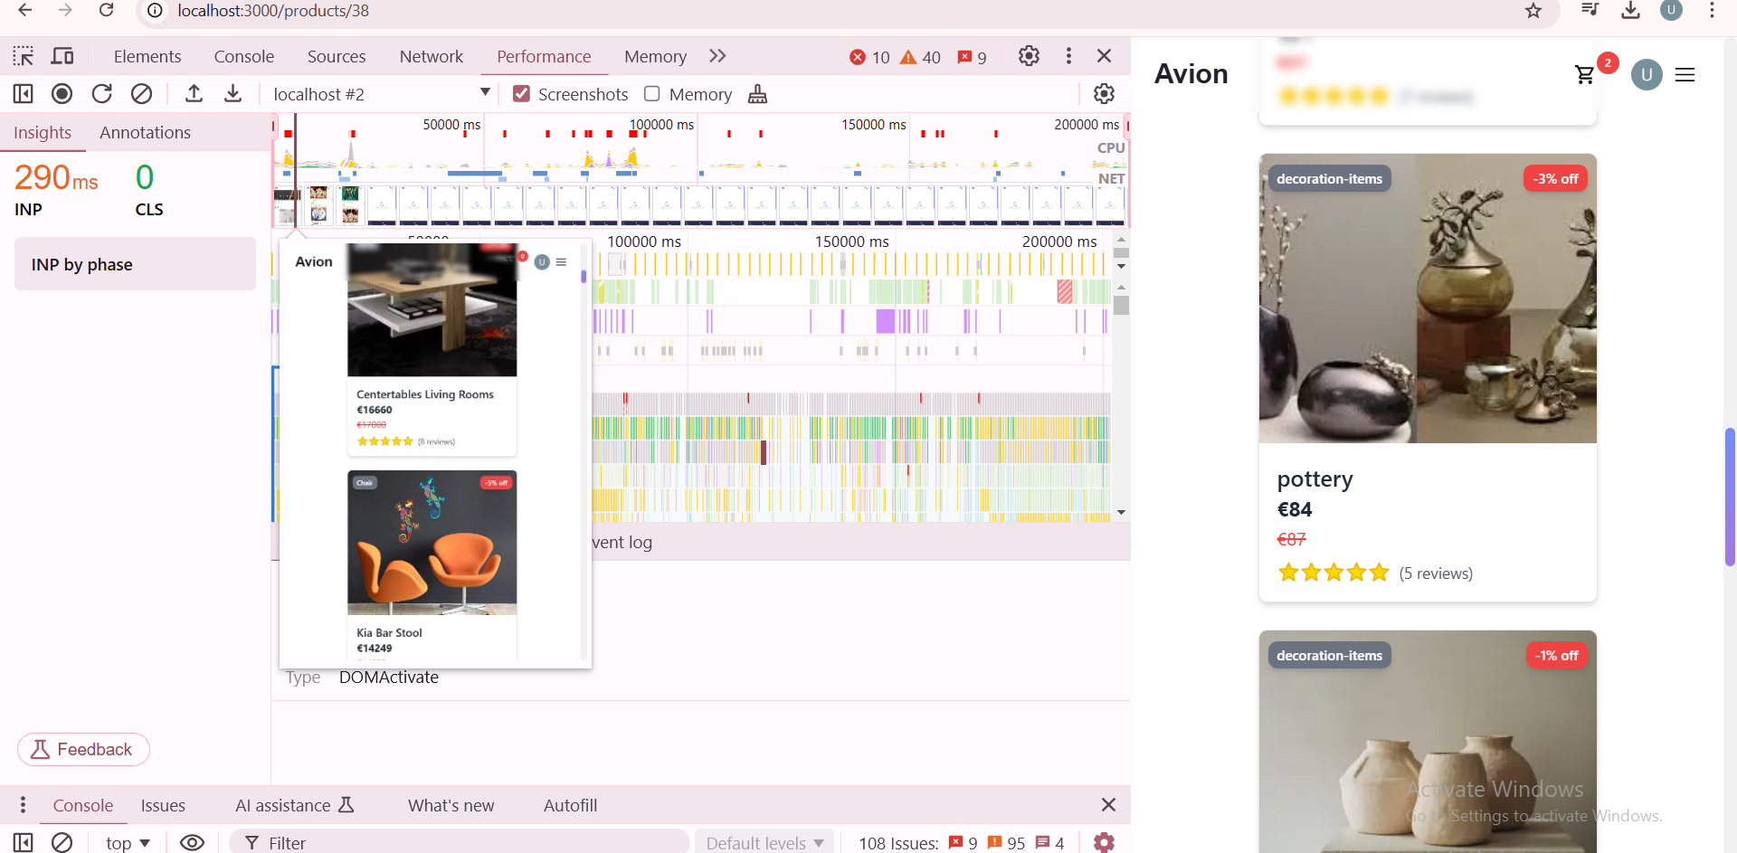
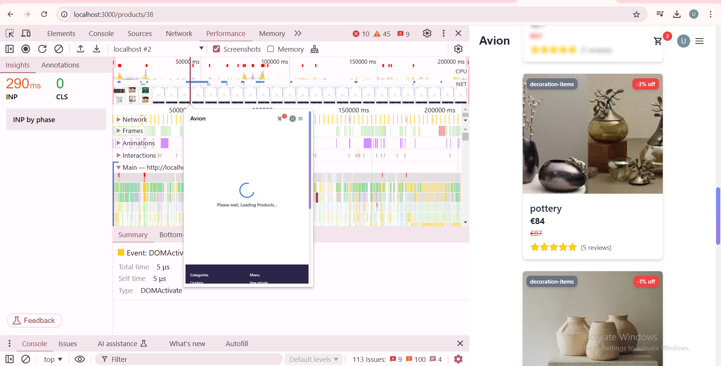
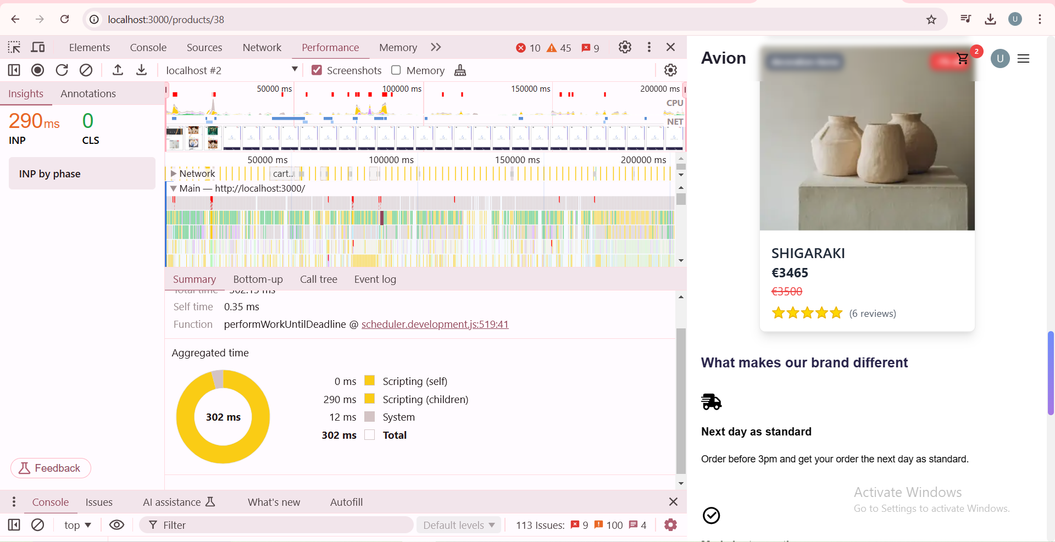
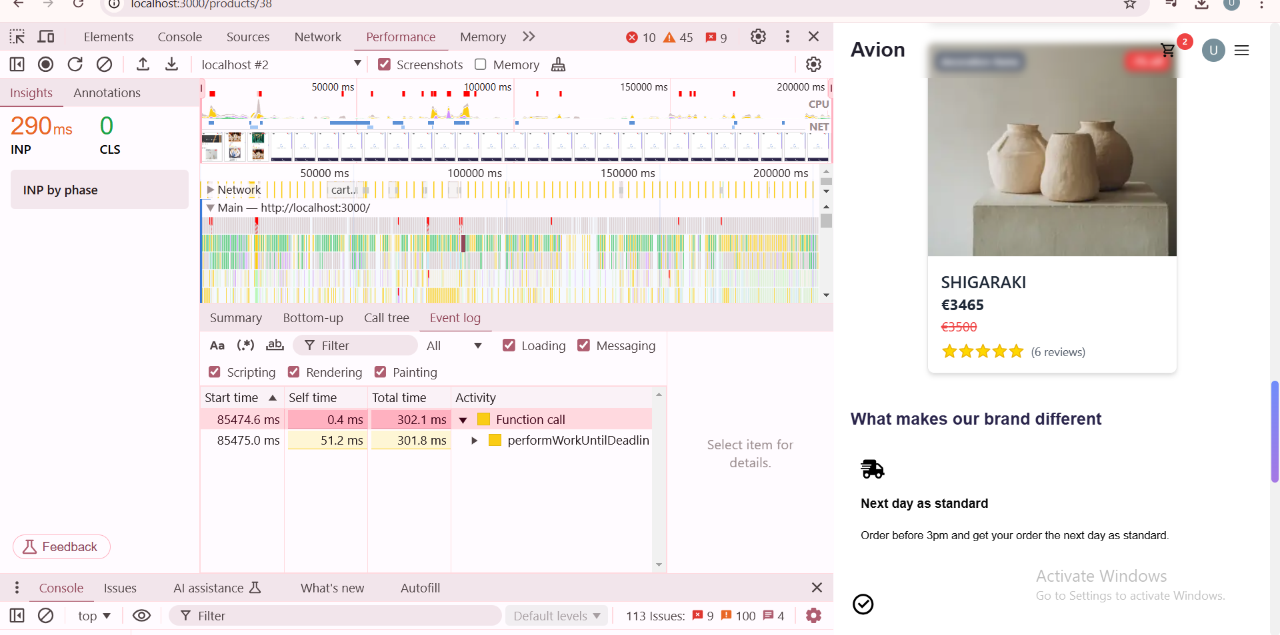
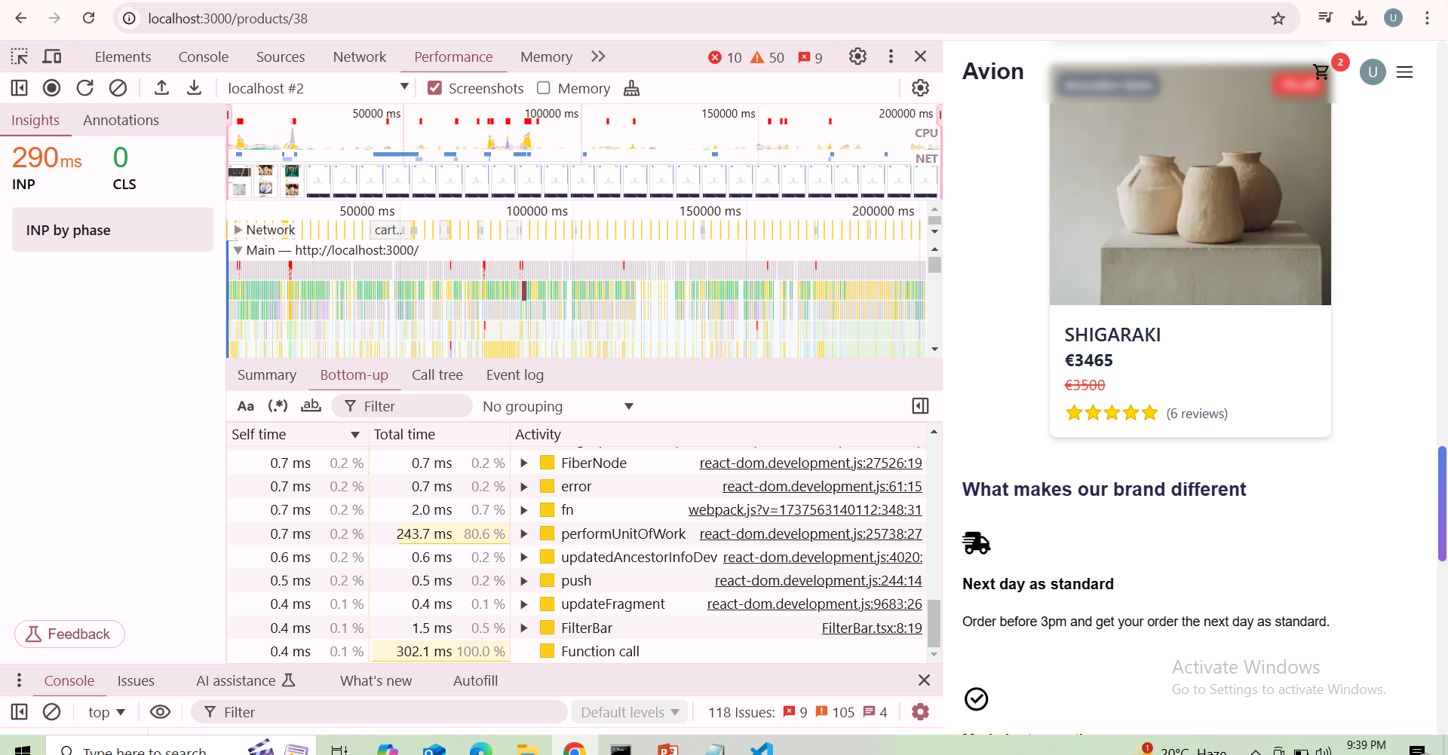
PERFORMANCE

Slide 7
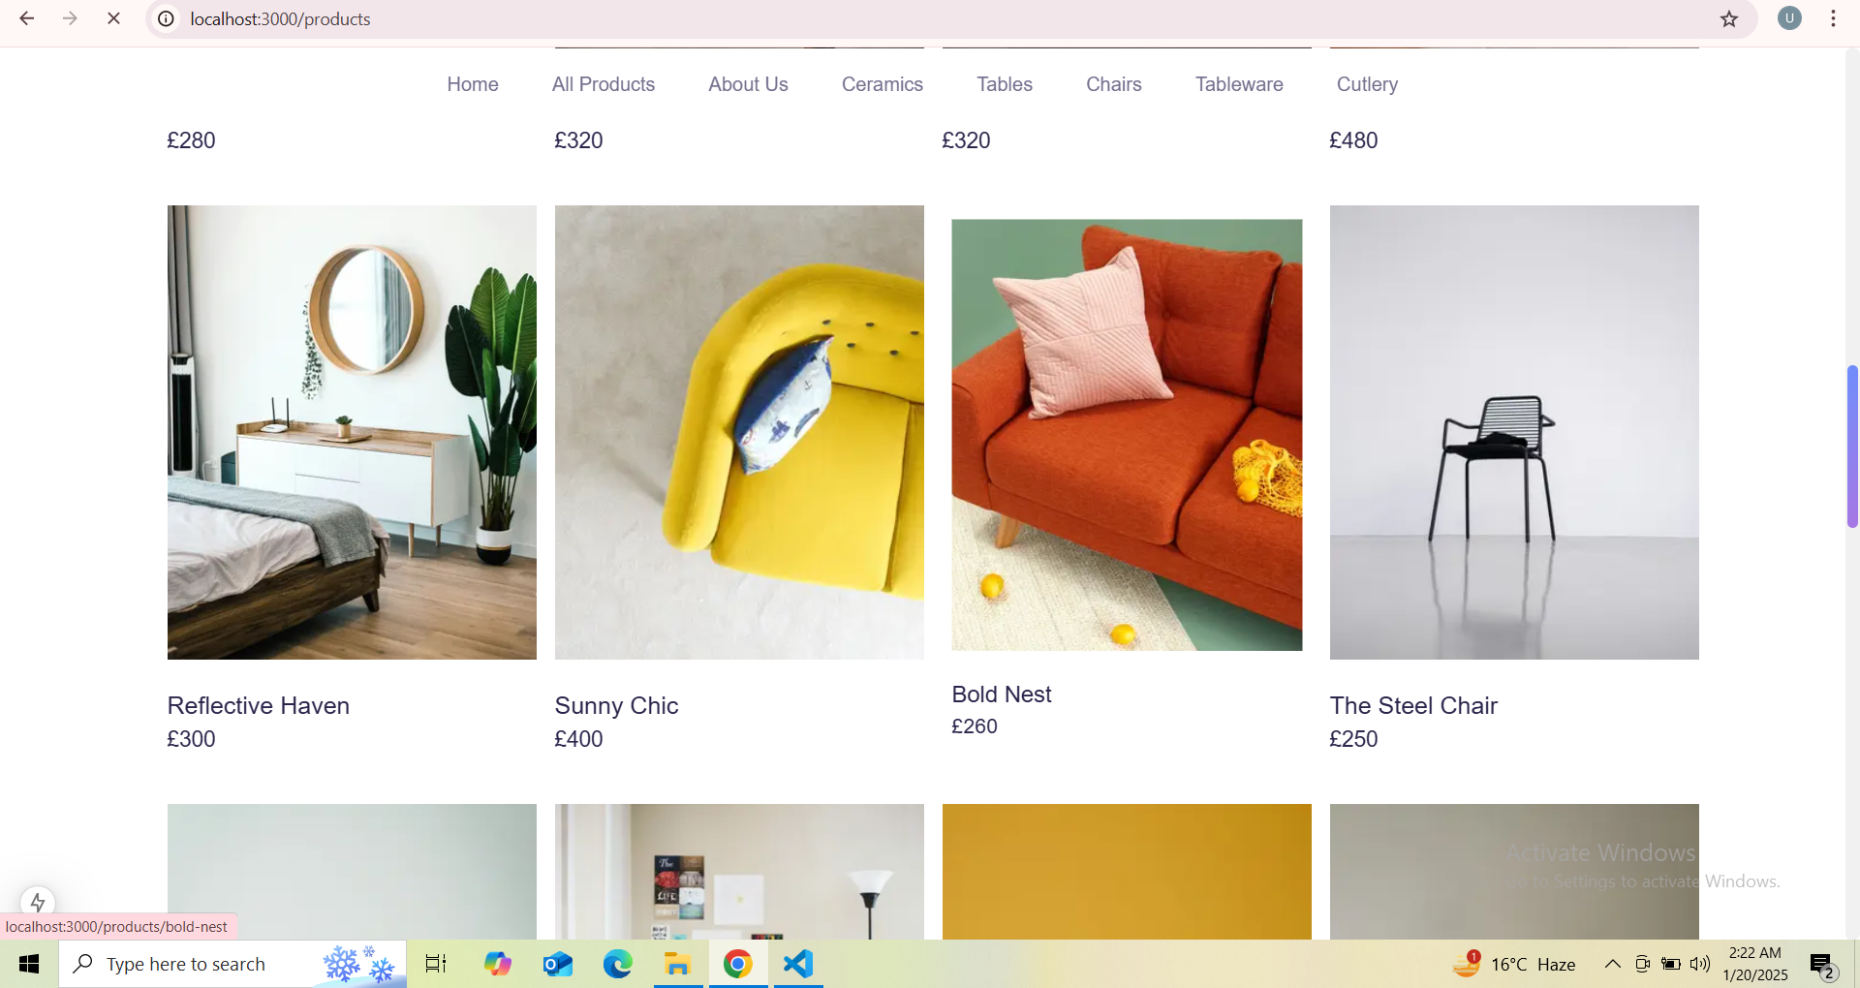

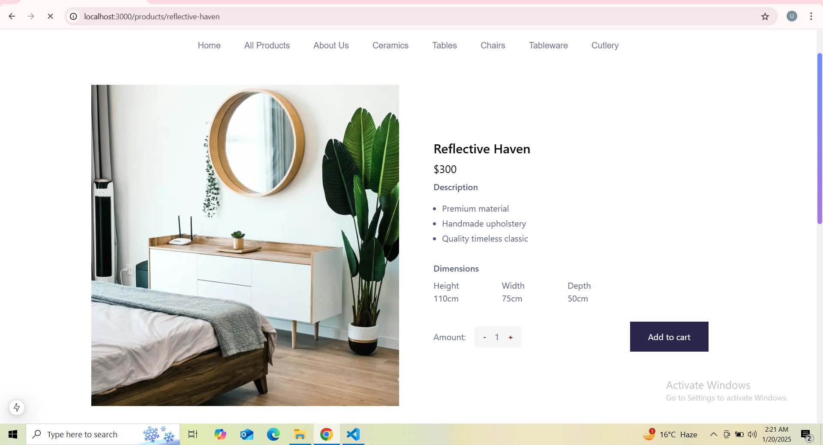
FUNCTIONAL TESTING
GET API
ADD TO CART
REQUIRED ITEM

Slide 8
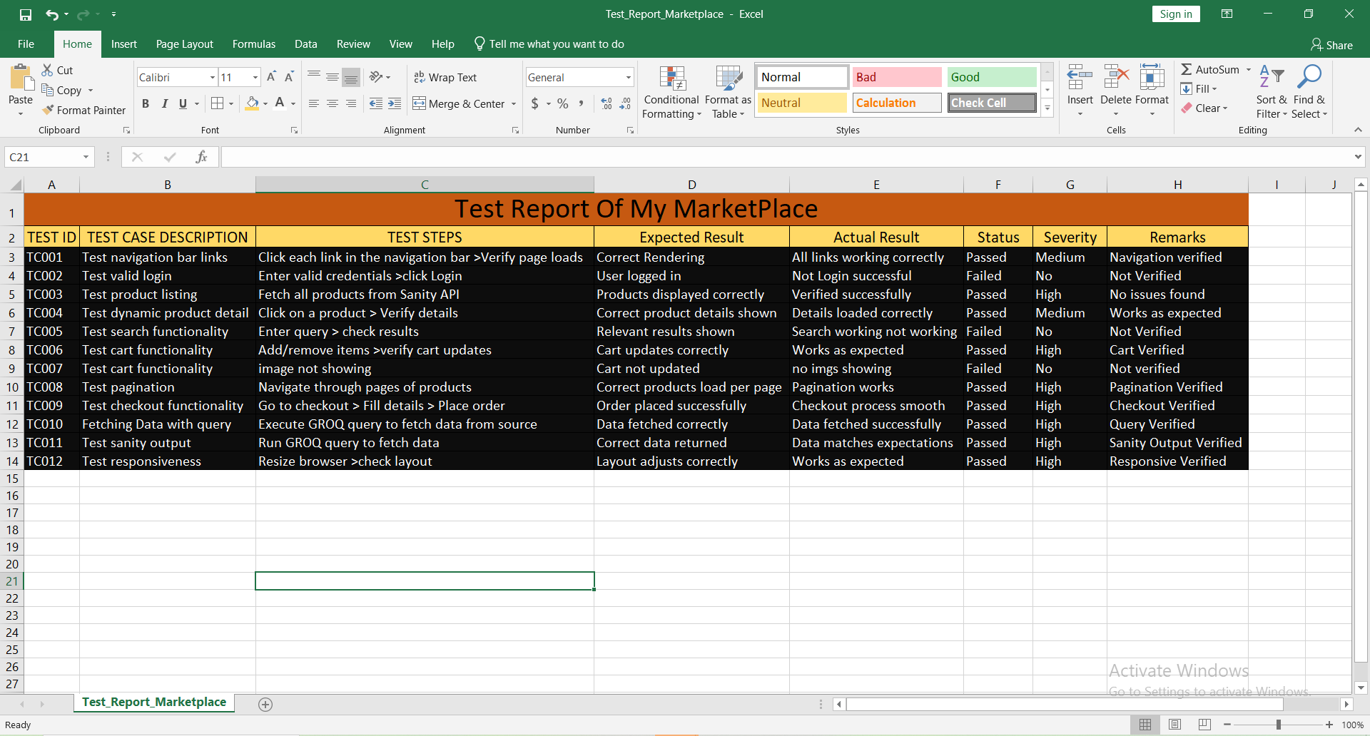
TEST_REPORT_MARKETPLACE

Slide 9
PREPARED BY :
My Experience:
Working on this project has been an incredible learning experience
From implementing advanced features to troubleshooting
deployment errors, I gained hands- on expertise in development,
testing, and deployment processes. This journey enhanced my
problem-solving skills , strengthened my understanding of modern
web technologies, and prepared me for real-world challenges in
building scalable and efficient applications.
UZMA AHMED

